Slide 1
Energy-economic modelling of UK energy scenarios
Dr Neil Strachan
n.strachan@ucl.ac.uk
MSc EDE – Energy Systems Modelling
University College London
23rd February 2011

Slide 2
Seminar Overview
Abstract
  This talk will explore energy-economic modelling of long term UK energy scenarios, with particular emphasis on the core policy goals of decarbonisation and energy security
Outline
  Overview of E4 modelling
    Energy-Economic-Engineering-Environment
  Sensitivity and uncertainty in energy models
  UK modelling and policy
    Overview of UK MARKAL model family
    Stochastic MARKAL – CCC 4th budget report, 2010

Slide 3

How NOT to undertake energy modelling...!
August 16th 1977 – 170 Elvis impersonators
2005 – estimated 85,000 Elvis impersonators

Slide 4
Assessing Energy, Economy, Engineering & Environment (E4) Interactions
ENERGY AND ECONOMY
AVAILABILITY/CHOICE
OF TECHNOLOGIES
GDP & CAPITAL
REQUIREMENTS
MARKAL-
MACRO/ED
ENERGY SERVICES
DEMANDS
MINING LIMITS &
TRADE (including IET)
ECONOMY AND SOCIETY
RESOURCES AND TRADE
ENVIRONMENTAL
LIMITS
ENVIRONMENTAL
EFFECTS
ENVIRONMENT
Notes:
32

Slide 5
What is a mathematical energy model?
A series of equations that either solve a real-world problem or represent a physical phenomenon
Based on observed and/or inferred data and insights
  i.e. revealed vs. stated preferences
Uses:
Predictive: used to predict the future; requires calibration
Interpretive: used as a framework for analysing a system and/or organizing field data; may not require calibration
  Good modelling defines boundaries, and identifies criticalities
A model generally contains only the significant features or aspects of the system in question
Two models of the same system or phenomenon may differ quite significantly.

Slide 6
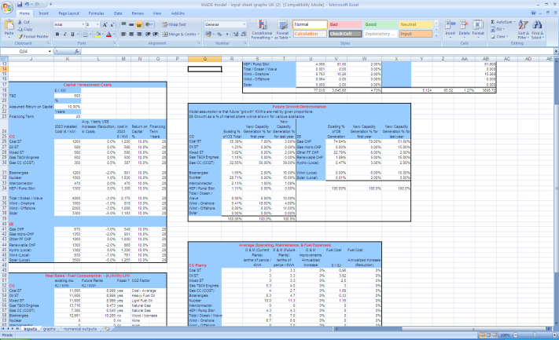
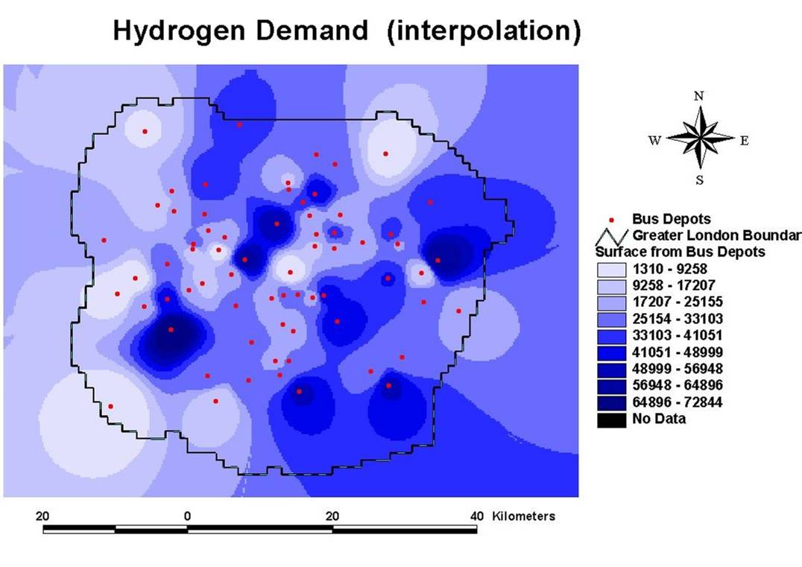
Modelling stages: e.g., London H₂ demand prediction (Hart et al.)
(1) Conceptual model (to answer hypothesis)
(4) Programme in software
(5) Interpret results
Stages 1-5: ITERATE
(2) Write equations
FC vehicles in Fleet (t) = FC vehicles in Fleet (t-1)*Purchase rate*(1-Disposal rate)
(3) Investigate data
Data availability and quality
Proxy variables

Slide 7
Models can be categorised in many different ways…
by overall objective:
  Energy demand planning….supply not investigated
  Energy supply (e.g. fuels and/or technologies)
  Integrated supply and demand…with iterations/feedbacks (i.e. whether costs of selected technologies, and/or energy prices affect energy demand)
(2) Static or dynamic: (dynamic = changes over time)
(3) Breadth/detail: e.g. sectoral, sub-sectoral?…
(4) Stochastic or Deterministic
Deterministic: outcome is a casual result of the initial conditions and model equations
Stochastic: a random variable(s) play a central role in solving the problem … must allow for random variability
(5) By perspective taken: ‘top-down’ or ‘bottom-up’
(6) Or, by ‘technique’ or methodology used

Slide 8
Energy Modelling typology
Bottom-up
Top-down
Behaviour
Computable general equilibrium
Macro-econometric
Simulation
Econometric
Optimization
Growth models
Hybrid Models
Integrated Assessment Models
Climate
Always a trade-off in model type, focus and implementation

Slide 9
Optimisation models
Seeking to optimise some goal or objective (termed the ‘objective function’) subject to specified constraints
  Many examples – e.g., MARKAL, TIAM-UCL, Osemosys, ETI-ESME
Two common types:
  Minimisation (over given time period) of costs for energy supply system in meeting demands for a sector or region
  Optimisation in operation of an energy system (e.g., electricity systems dispatch – e.g. use of merit order for least-cost operation)
Starting point is just a representation of a system (i.e., a simulation). Then add in:
  an objective function – e.g. sum of simulated costs, to be minimised
  specified constraints – e.g. power supply must equal or exceed demand
  Some mathematical technique to seek minimum or maximum (e.g. linear programming)

Slide 10
Optimisation example
y
Profit maximising output combination (x, y)
Isoprofit lines
(e.g. 30x + 40y = z)
A firm produces X and Y which yield a profit of £30 and £40 per unit respectively
The firm wants to find the combination (x, y) that maximises its daily profit but that is also feasible with its three departments:
  Max 30x + 40y (daily profit)
  Subject to 3x + 2y ≤ 44 (A) x + y ≤ 16 (B)
  x + 2y ≤ 24 (C)
Constraint C
Feasible Set
Constraint A
Constraint B
0
x

Slide 11
Simulation models
Most common type of energy model
  Note; sometime accounting and simulation model types are differentiated
  e.g. POLES, LEAP
Attempting to simulate a ‘system’ of interest by representing the relationships between key parts of it
Can range from simple relationships between a few ‘actors’ or factors of interest
  e.g., demand for energy = Some function of GDP and population (an econometric function, as previously)
To complex representations of many factors interacting
  e.g. ‘System Dynamics’, or ‘Reference Energy Systems’
And can seek partial equilibrium (where inputs are automatically adjusted to be consistent with calculated outputs) or rely on external manipulations to make inputs & outputs consistent

Slide 12
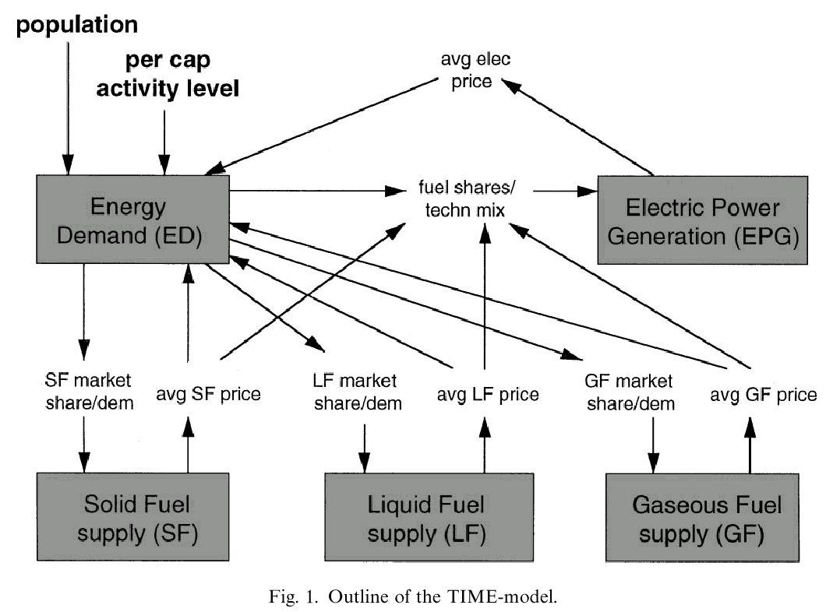
Electric power simulation: the TIME model
Source: B. De Vries et al., Energy Policy, 27(8): 477-494
Feedback of price to demand: can seek an ‘equilibrium’
Partial equilibrium, simulation model

Slide 13
Econometric models
Use of statistical techniques applied to determine parameter values based on analysis of historical relationships with other (input) parameters
  Most commonly used for demand projections, based on parameters such as population, incomes, assumed technical progress (AEEI)
  Are in essence simulation models
  Typically use Regression to determine influence of a set of parameters on the dependent variable
Range from simple models with few parameters to those with many variables (e.g., energy sources, sectors, energy uses etc)
Usually requires long historical time-series of data for all input parameters
Will historic relationships hold?

Slide 14
DECC Econometric Model structure
Transport
Industry
Projections currently to 2025
Domestic
Services
Final energy demand
Electricity supply model
CHP projections
Electricity price
CO₂ emissions
PRIMARY ENERGY DEMAND
+
LULUCF
UK Net Carbon Account
+
Non-CO₂ emissions
100+ demand econometric equations (by sector and fuel):
Ln Demand = constant + α*Ln X + β*Ln Y + γ*Ln Z …. + e
where X, Y, Z are lagged value (t-1); economic output, relative prices, time trend, temperature, other…, e is the residual error term
Log-log regression means coefficients are elasticities (% changes)

Slide 15
CGE models
CGE: Computable General Equilibrium (static or dynamic)
Many examples – EPPA, MERGE, SGM, AIM etc
A CGE model consists of:
  Tables of transaction values, input-output table or as a social accounting matrix (SAM)
  Production function (labour, capital, materials, energy, other)
  Elasticities: dimensionless parameters that capture behavioural response (e.g., price, demand, trade, income elasticities etc)
Include government and foreign trade, use equations that specify supply and demand behaviour.
Solve model with a set of exogenous parameters (technology, wages, prices, exchange rates) to bring all markets into equilibrium
Not able to provide insights into the adjustment process between equilibrium
Parameters are only partially statistically or econometrically calibrated (i.e., they are selected to fit one or few years of data)

Slide 16
Five critical modelling issues
Technology
  Global drivers; national applicability; niche markets
  Economies of scale, of learning, of scope
Behaviour
  Firms vs. individuals
  Profit maximising and non price drivers?
  Role of the state
Scale
  Global drivers vs. National policies vs. local planning vs. individual use
Time
  Instantaneous vs. short-, long- and very long-term
  Non marginal changes (sideswipes)
Uncertainty
  Parametric – imperfect knowledge
  Stochastic – inherent variability
  Transparent model assumptions and dynamics

Slide 17
Definition of (E4) energy models
Energy-economic models are systematic tools to generate insights into the potential evolution of the energy system, and its interactions with the overall economy and the environment
But: E4 modelling as Science or Art or Both ?

Slide 18
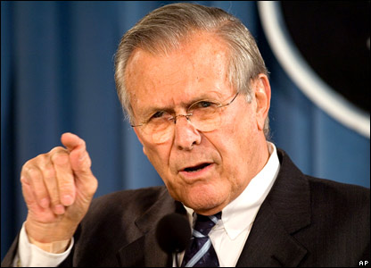
“There are known knowns. These are things we know that we know. There are known unknowns. That is to say, there are things that we know we don't know. But there are also unknown unknowns. There are things we don't know we don't know.”

Slide 19
Characterization of model uncertainty
Uncertainty in models can be characterized as:
  Uncertainty about underlying values (address via scenarios)
    e.g., consumer preferences, government priorities
  Parametric uncertainty
    Arises through imperfect knowledge, address via sensitivity analysis
  Stochastic uncertainty
    due to inherent variability in inputs and processes
  Uncertainty about model structure
    The structure of models are derived by human trial and error and represent a world-view
    Address via model comparison (crucially of different model types), or modelling to generate alternatives (MGA)

Slide 20
Dealing with model uncertainty
Modelers have worked to replicate best current understanding and historical evidence of dynamics in physical and social sciences
  BUT, many dynamics are not well understood
An explicit treatment of uncertainty is now the goal of modelers
One oft used approach is for a more complex model treatment to unpick uncertain processes, for example:
  Moving beyond an assumed exogenous improvement in the costs of new energy technologies, to embody technological change via learning curves
  Cost = C_{t=0} * CumCap ^{-β}
  where: C_{t=0} is initial cost; CumCap is cumulative capacity; b = learning elasticity
  and (1-2^{-β}) is the learning rate - cost reduction for doubling of capacity
  BUT, uncertainty remains on initial values, floor values, learning rate, short term impacts, direction of effect etc

Slide 21
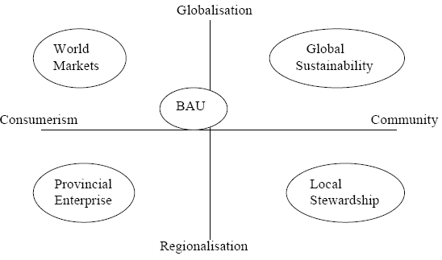
Scenarios as high level trend studies
Source: UK government foresight exercise

Slide 22
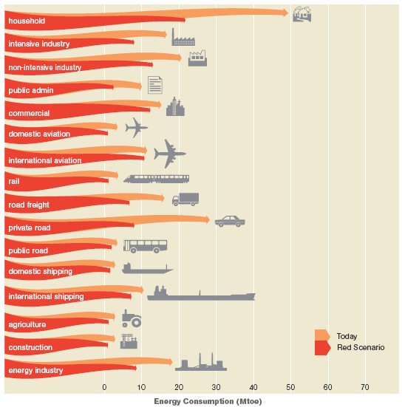
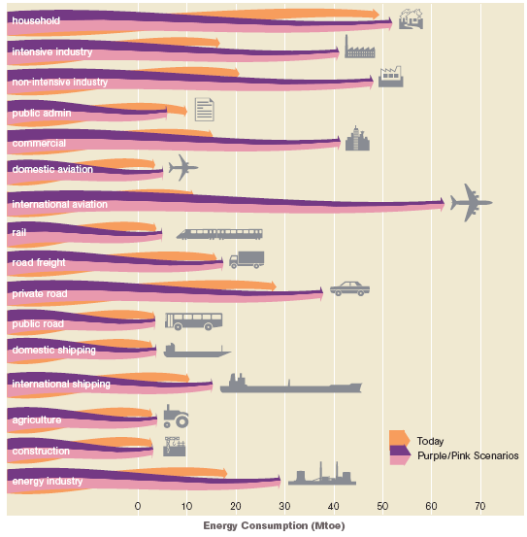
Scenarios as technical feasibility studies
Source: Tyndall Centre scenarios

Slide 23
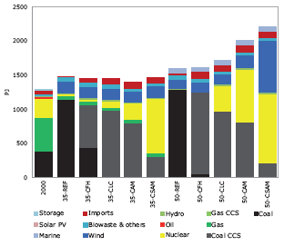
Scenarios as modelling studies
Source: UK MARKAL model

Slide 24
The Deus Ex Machina in Energy Scenarios
Key example: environmental limits (CO₂)
Interventions upon technical systems are made through ‘unrealistic’ modelling or scenario ‘contrivances’
  Not explained by required actor actions
  Infrastructure and lock-in often sidelined
Key aspects of highly iterative processes are isolated as exogenous assumptions
  ‘strong policy’
  ‘technological development’
  ‘green attitudes’ or ‘compliant citizens’

Slide 25
Categorising uncertainty in energy scenarios
Predetermined elements
  Common to all scenarios
Actor contingent elements
  Usually specific or intrinsic to particular scenarios
Non actor contingent elements
  Impacts could apply to all scenarios
Who is the scenario actor?

Slide 26
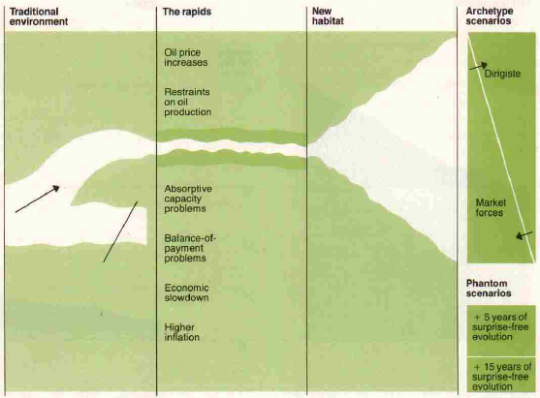
But scenarios can actually reduce uncertainty
Ground in the present
Be explicit on possible branching points
Be explicit of rates of change of key inputs
Source: Wack (1985)

Slide 27
Sensitivity analysis
A common yet powerful technique to understand the impact of uncertainties
  Key inputs (e.g., resource prices; $/barrel of oil etc) are varied deterministically in a model with the difference in alternate sensitivity runs being the key element.
  Sensitivity analysis is most useful for parametric uncertainties or those driven by discrete decision making
    e.g. is nuclear power an option for consideration?
  But issues with internal consistency
    e.g. under carbon reduction targets can fossil fuel prices ever go up ?

Slide 28
Sensitivity analysis of uncertainty (Stern, 2006)
- range of cost estimates for mitigation options

Slide 29
Base-case UK emissions
(2007 Energy White Paper)

Slide 30
Probabilistic / Stochastic analysis
Probabilistic or stochastic analysis treats uncertain inputs as random variables
Uncertainty is expressed via a discrete or continuous probability distribution function (PDF)
Sampling techniques (e.g. Monte Carlo) can then combine uncertainty from different PDFs (for different inputs)
  If these are linked via a series of equations then this uncertainty can be propagated through the system to generate uncertain outputs
This technique can be used to calculate a formal understanding of solutions under uncertainties.
  Identifying hedging and/or robust strategies
  Identifying recourse strategies if that uncertainty is resolved during the model horizon (stochastic programming)
  Formal measures of the value of understanding uncertainties (e.g. the Expected Value of Perfect Information (EVPI))

Slide 31
How do you define the probability density function?
2
1
Performance
Performance
Probability
3
4
Performance
Performance

Slide 32
Error propagation via Monte Carlo simulation
Leads to probability distribution in modelled results
Source: Stern (2006)

Slide 33
Structural model uncertainties
One option is to compare similar input runs under different model types
Another is to undertake multi-criteria optimisation
  But still have one objective function (plus constraints) and hence one solution
  Can weight alternate criteria
Another is modelling to generate alternatives (MGA)
  Solve (optimisation) model under original objective function – e.g. cost minimisation
  Set threshold based on this original solution (e.g. +10% of discounted costs)
  Define new objective function – e.g. minimise fossil fuel imports
  Search in solution space when also meeting imposed threshold level

Slide 34
Model uncertainty discussion
  Require consistent, integrated storylines
    Encompass changing landscape and values
    Check for actors role and transitional feasibility
Sensitivity analysis on parametric uncertainties
Probabilistic approaches to random variability
Investigation of model structural uncertainty
Policy must be explicitly cognisant of future uncertainties
    Balanced consistency in carbon pricing, technological development and non-price barrier removal
    Retain an iterative element to stringent CO₂ reduction policy, under path dependency

Slide 35
Conclusions for good E4 modelling
Let the research issue drive the model
Different categories of models all have strengths and weaknesses
  Consider a consistent combination of models (linked or not)
Worry about
  Technology, Behaviour, Macro impacts, Scale, Time,
Be explicit in regards to Uncertainty
But increasing computing power can lead to over-complication, beyond ability to understand and critique
  Model to generate insights, not just numbers

Slide 36
SEMINAR BREAK

Slide 37
MARKAL modelling for UK policy
2000
2007
2008
2010
EWP 03
CAT Strategy
Energy Review
EWP 07
CC Bill
LCTP
CCC reports → →
Model type
MACRO
MED
STND
STND
TIMES, Stochastic
UK Government, CCC
Funding
UK Government
UKERC, Research council projects, UK-Japan LCS , Ofgem, NGOs etc
Rapid simple structured model development to inform EWP 03
CCS enhancement for CAT strategy
Major 2 year UKERC programme; enhanced UK model with MACRO extension
MED model development with major CCC and UKERC scenarios
Stochastic MED model , Global TIMES model (UKERC)
Notes:
37

Slide 38
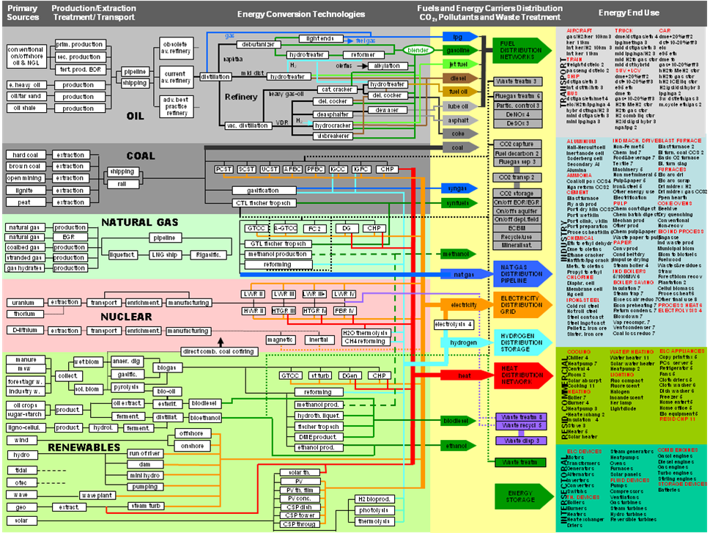

Slide 39
Introduction to UK MARKAL model
A least cost optimization model based on life-cycle costs of competing technology pathways (to meet energy demand services)
Partial equilibrium model assuming rational decision making, perfect information, competitive markets, perfect foresight
Technology rich bottom-up model
  end-use technologies, energy conversion technologies, refineries, resource supplies, infrastructures etc
An integrated energy systems model
  Energy carriers, resources, processes, electricity/CHP, industry, services, residential, transport, agriculture, emissions, taxes, demands
Physical, economic and policy constraints to represent UK energy system and environment
Model and data validation
Emphasis on sensitivity and uncertainty analysis
Extension to MARKAL-Macro (M-M), elastic demand (MED), stochastic, mixed integer, multi-region, global TIAM-UCL model, other variants

Slide 40
Components of MARKAL

Slide 41
Running the UK MARKAL models
Objective function
  MARKAL minimises discounted energy system costs
  M-M maximises overall discounted utility
  MED maximises total societal welfare (producer & consumer surplus)
Initial calibration to UK energy system in year 2000
  Depiction of existing infrastructures, installed energy technologies, current policies, physical constraints
  Calibration for final energy, CO₂ emissions & electricity generation
Model then optimizes in 5-year time steps through to 2050
  Changing energy resources supply curves
  Exogenous trends in energy service demands
  Changing technology costs (vintaging & exogenous learning curves)
  Physical and policy constraints
  Taxes and subsidies
  (And in M-M, MED) varying energy service demands
A full range of scenarios and sensitivity analysis is carried out in a systematic ‘what-if’ framework

Slide 42
Stochastic UK MARKAL
Built on technologically detailed, partial equilibrium energy systems optimisation MARKAL model
  www.ukerc.ac.uk/support/tiki-index.php?page=ES_MARKALModelFamily&structure=Energy+Systems
Development of a new stochastic variant of UK MARKAL
  Key uncertainties categorized by alternate outcomes of a random variable
    Two stage stochastic programming solution
    Defined by states of the world [SOW] – discrete (e.g., 50/50 likelihood), or via a probability density function
  The partial equilibrium objective function is maximised based on the expected weighted costs for each state of the world (SOW) based on the assumed probabilities and the costs for that SOW
    Expected Cost_{Scen} = ∑(Cost_{SOW} * Prob_{SOW})
    EC = maximisation of producer plus consumer surplus (i.e. welfare): annualised capital, fuel, O&M, emissions charges, taxes/subsidies, salvage costs, demand reductions
BUT…
  Subjective choice of which uncertain variables and how to assign probabilities
  Requires at least transparency and justification, at best full expert elicitation

Slide 43
Key parameters of the UK MARKAL MED model
Key parameter | Description
Conversion factors | GDP deflators: 2000 = 100 ; 2005 = 116.9 ; 2008 = 123.9 Exchange rates: $/£ = 1.8, €/£ = 1.4 Physical: 1 MTOE = 11.6 TWhr = 48.9 PJ
Discount and hurdle rates | Global discount rate of 3.5% (www.hm-treasury.gov.uk/data_greenbook_index.htm) Hurdle rates are implemented on conservation in buildings sectors (12.5%); and transport technologies (10% for public, 10% for hydrogen private, 7.5% for battery and methanol private)
Carbon Target | 2050 target of -80% (118.6MtCO₂) relative to 1990 emissions of 592.4MtCO₂. Equal annual reduction from 2020 target of 380.2MtCO₂ (35.8% reduction from 1990 levels)
Fossil Fuel Price 2000-2050 (2000£/GJ) | Central case | Oil | 4.12 | 9.35 | 6.41 | 6.87 | 7.33 | 7.79 | 8.25 | 8.25
 |  | Gas | 1.93 | 4.47 | 4.47 | 4.85 | 5.16 | 5.47 | 5.70 | 5.70
 |  | Coal | 0.91 | 2.97 | 2.23 | 1.62 | 1.62 | 1.62 | 1.62 | 1.62
Fossil Fuel Price 2000-2050 (2000£/GJ) | Low case | Oil | 4.12 | 9.35 | 4.58 | 5.31 | 5.50 | 5.50 | 5.50 | 5.50
 |  | Gas | 1.93 | 4.47 | 2.62 | 2.70 | 2.70 | 2.77 | 2.77 | 2.77
 |  | Coal | 0.91 | 2.97 | 1.62 | 1.01 | 1.01 | 1.01 | 1.01 | 1.01
Biomass Imports | Import constraint (increasing geometrically to 1,260PJ by 2050) Sensitivity on no bio imports
Energy service demand | 25% maximum reduction. Own price elasticity range from 0.25 to 0.61 dependent on specific ESD
Policy variables & energy taxes | As of 2008 Energy Bill [www.decc.gov.uk/energy/whitepaper/] Note, no EU-ETS price in reference case
Technologies | As in documentation (www.ukerc.ac.uk) with additions including biomass CCS, infrastructure costs by scale and distance, additional district heat/CHP options, increased CCS costs and efficiencies, restricted capacity (30%) of residential heat pumps and night storage

Slide 44
Stochastic MARKAL: CCC 4th budget report
Legislated UK carbon budgets, within GHG targets of -34% by 2020 & -80% by 2050
Analytical underpinning provided by a range of modelling frameworks
  macro-economic, partial equilibrium energy systems optimisation, econometric, integrated assessment, sectoral (networks, buildings, and transport), etc.
Almost all are deterministic, providing extensive sensitivity analysis of pathways to meet 2010-2050 carbon abatement targets
However, they are dependant of a range of uncertainties that are not resolvable at the current time (and not by UK actors)
  Will new energy technologies achieve desired technical and cost criteria?
  Achievable build rates of new (low carbon) infrastructures?
  Price path and availability of fossil resources and sustainable biomass imports?
  Evolution in future demands for (price elastic?) energy services?
  What UK emissions targets will need to be in a global mitigation context?
Hence, policy making under deep uncertainty

Slide 45
Stochastic MARKAL Scenario
Cumulative (2000-2050) CO₂ emissions (19.01 GtCO₂)
  Equivalent to annual target (-34% in 2020; -80% in 2050)
Only in 2030 is CO₂ target imposition confirmed (or not)
  Stage 1: Hedging strategy (through the 2020s)
  Stage 2: Multiple (per SOW) recourse strategies (2030-2050)
Optimal solutions
  5%, 10%, 30%, 50%, 70%, 90%, 95% prior probability of CO₂ target
Choice of resources, technologies, infrastructures, demand changes
CO₂ marginal price, welfare cost
  Penalty vs. deterministic runs

Slide 48
Electricity generation 2025 (hedging period)
[PJ] | CUM-C80 | ST-C-70% | ST-C-30% | ST-C-10% | REF
Coal | 20 | 20 | 167 | 305 | 340
Cofiring | - | - | - | - | -
Cofiring CCS | 197 | 186 | - | - | -
Coal CCS | 19 | - | - | - | -
Gas | 309 | 331 | 363 | 372 | 309
Gas CCS | - | - | - | - | -
Biomass CCS | - | - | - | - | -
Nuclear | 282 | 282 | 282 | 282 | 216
Oil | - | - | - | - | -
Hydro | 31 | 31 | 31 | 29 | 19
Wind | 195 | 183 | 175 | 141 | 140
Bio&waste CHP | 62 | 65 | 80 | 82 | 144
Imports | 77 | 77 | 76 | 26 | 27
Marine | 37 | 36 | 26 | - | -
Solar PV | - | - | - | - | -
Storage | 6 | 6 | 6 | 6 | 6
Total | 1236 | 1217 | 1205 | 1243 | 1262
Share of renewable | 26.4% | 25.9% | 25.9% | 20.3% | 24.1%

Slide 51
Costs in perspective
[Source: D MacKay, Sustainability without the Hot Air]
All in 2009 US $
Expenditure | Cost per year (B$/yr) | One time cost (B$) | Cost per UK resident ($/yr or $)
2050 -80% CO2 welfare costs (2000£ 12-23) | 22 - 43 | - | 300 - 580
UK GDP | 1300 | - | 21700
UK Bank bailout | - | 500 | 8300
Health budget | 159 | - | 2650
Education budget (to 18yrs) | 85 | - | 1420
BP*, Shell, Exxon profits | 10-40 | - | -
Nuclear decommissioning | - | 73 | 1220
New nuclear weapons | - | 25 | 420
Final energy consumption | 112 | - | 1870
Renewable energy R&D | 0.012 | - | 0.2

Slide 52
Value/costs of (not) considering uncertainty
NAÏVE – subjective – here, assuming NO CO₂ cap
  EVIU – expected value of ignoring uncertainty
  The value (cost) to the decision maker if uncertainty is ignored
  EVIU = E_{α}[C(X _{naive,1}|α)] – E(C*)
  and E_{α}[C(X _{naive,1}|α)] = C₁(X _{naïve,1}) + Σ_{α} [P(α) * C₂(X₂ *(α,X _{naïve,1})| α, X _{naïve,1})]
  i.e., the expected value of the optimal hedging strategy, compared to the expected cost of a scenario that is dependent on the hedging period from a given (naïve) strategy.
OPTIMAL HEDGE or E(C*) – dependent on assumed probabilities
  EVPI - expected value of perfect information
  The value to the decision maker if uncertainty is removed
  EVPI = E(C*) - ∑_{α} [P(α) * C(X_{pi})]
  i.e., the expected value of the optimal hedging strategy, minus the summed costs of the scenarios under perfect foresight multiplied by the probability of these scenarios occurring
PERFECT INFORMATION – i.e. deterministic solution

Slide 53
EVIU and EVPI

Slide 54
Summary
Long-term UK energy policy decision making under deep (non resolvable?) uncertainties
Stochastic MARKAL as one model to investigate
  But require transparency on why/how choose and assign uncertainties
Single hedging and multiple recourse strategies
Example of cumulative CO₂ target setting
  Asymmetric and significant costs of ignoring uncertainty (EVIU)
  Inertia of system under decarbonisation pathways
  Feasibility of recourse strategies?

